Slide 1
Ethics and Social Justice
An Introduction

Slide 2
Outcome 1.1
examine what is meant by social justice, social activism and global responsibility

Slide 3
What is social justice?
Equality?
Human Rights?
All entitled?
http://www.youtube.com/watch?v=z754lhcX6qw&safety_mode=true&safe=active&persist_safety_mode=1
Ethics & Social Justice, p. 7

Slide 4
What is social activism?
“Social activism is an intentional action with the goal of bringing about social change. If you feel strongly about a cause and are working towards a change, you could be considered an activist. An activist is anyone who is fighting for change in society. An activist can be a student attending a rally against tuition increase, a politician fighting against international human rights abuses or a mother of a child killed by a drunk driver talking to students about drinking and driving. Social activists consider the larger picture – how can they find ways to end injustice and to create strong communities which encourage economic, social and psychological health.”
https://www.amherst.edu/campuslife/careers/students/picareers/careers/social_activism

Slide 5
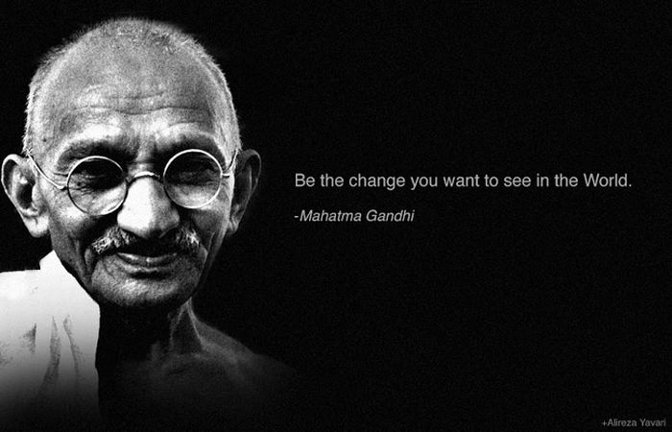

Slide 6
What is social responsibility?
Being socially responsible refers to the ethical idea that individuals or groups of individuals are obligated to act to benefit the larger society.

Slide 7
Example – Toms Shoes
When you buy a pair of Toms shoes, a second pair is given to a child in need.
They also donate eye care to those in need when someone purchases their sunglasses.
Is this an act of social activism?
Is the company acting socially responsible? Or is it simply an advertising technique?
Can you think of other companies that claim to be socially responsible?

